Slide 1
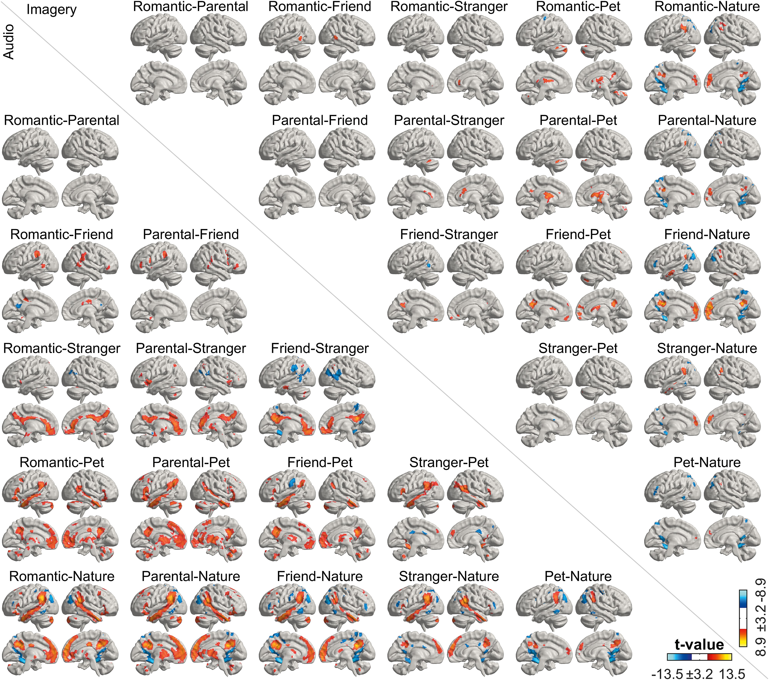
Fig. 7 Pairwise contrasts between different types of love for audio (lower triangle) and imagery (upper triangle) ...
Notes:
Fig. 7 Pairwise contrasts between different types of love for audio (lower triangle) and imagery (upper triangle) conditions. Contrasts are thresholded at Pvoxel < 0.001, Pcluster < 0.05 FWER. Color scales for audio and imagery conditions are indicated at the bottom right corner.
Unless provided in the caption above, the following copyright applies to the content of this slide: © The Author(s) 2024. Published by Oxford University Press.This is an Open Access article distributed under the terms of the Creative Commons Attribution License (https://creativecommons.org/licenses/by/4.0/), which permits unrestricted reuse, distribution, and reproduction in any medium, provided the original work is properly cited.

